Slide 1
Discovering Incredibly Outstanding Danish Electronics

Slide 2
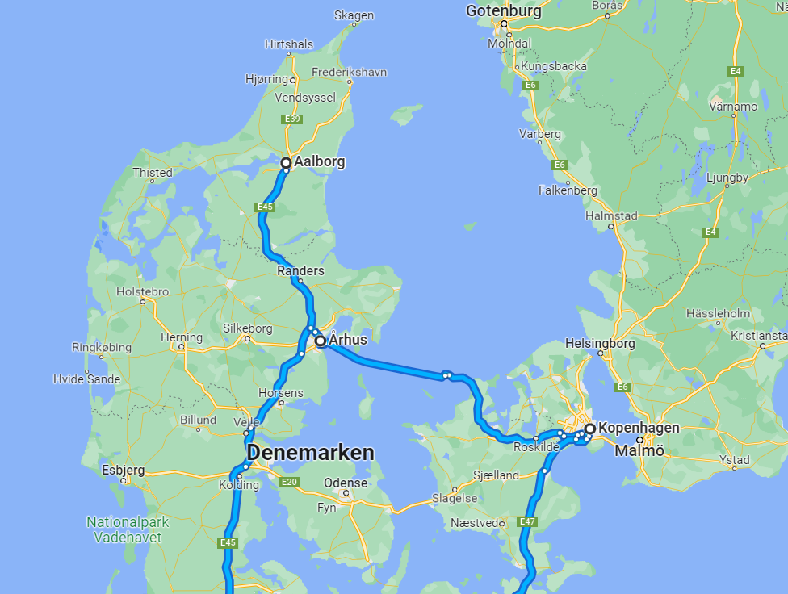
Diverse areas of technologies in EE
High ranking Universities
Well known companies
Great culture
3 nice cities:
Aalborg
Aarhus
Copenhagen
Discovering Incredibly Outstanding Danish Electronics

Slide 3
Planning
5 days – 6 nights
Depart on the night of Tuesday May 16th
Return in the early morning of Monday May 22th
Aalborg: May 17th – 18th
Arhus: May 18th – 19th
Copenhagen: May 19th – 21st
Discovering Incredibly Outstanding Danish Electronics

Slide 4
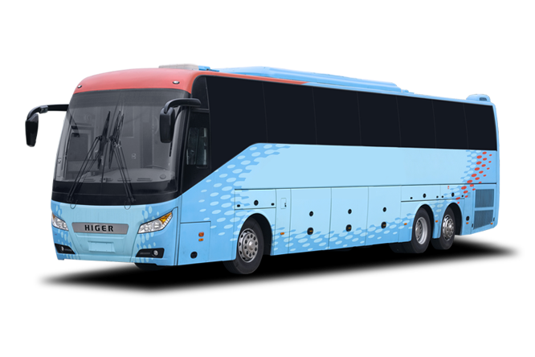
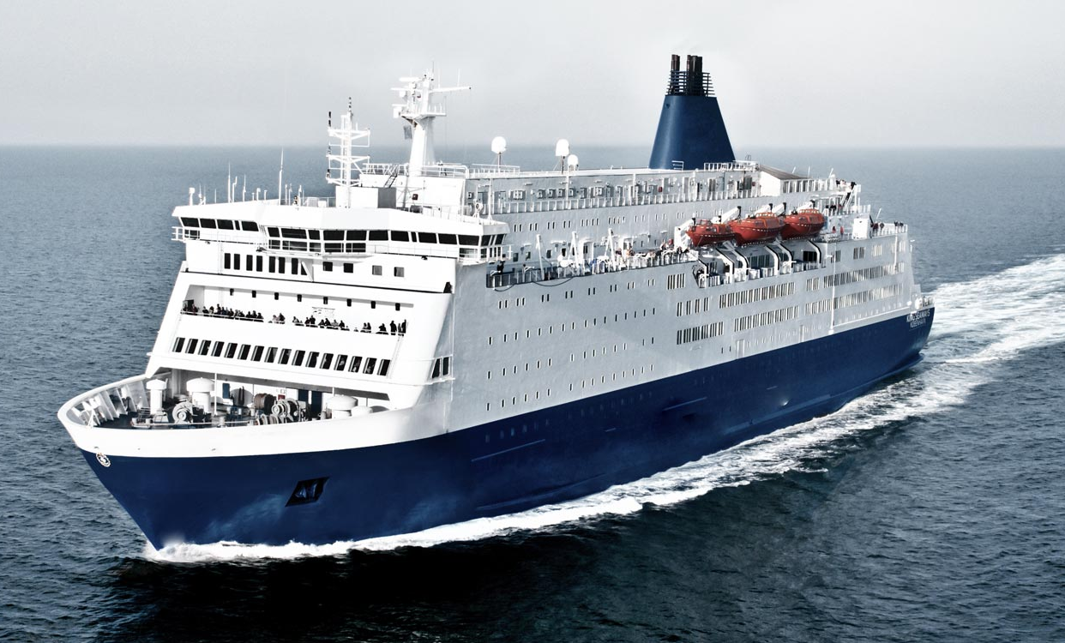
How?
With the bus! …And the ferry
Discovering Incredibly Outstanding Danish Electronics

Slide 5
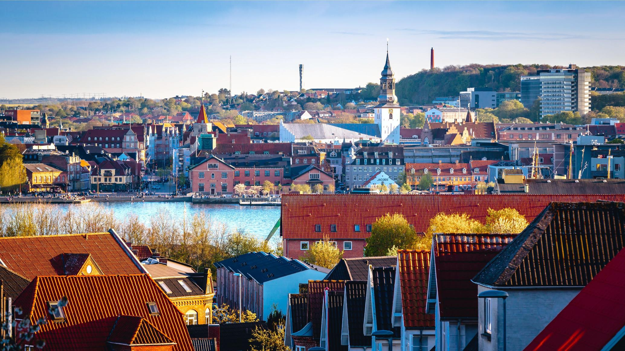
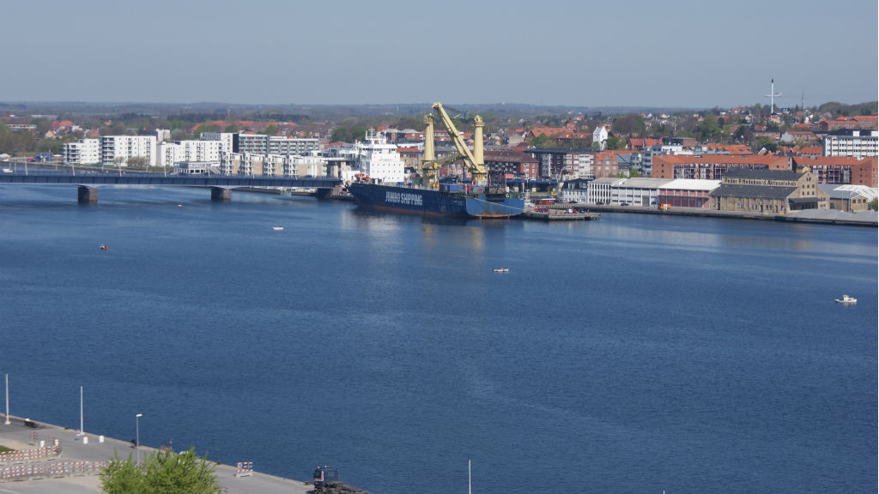
Aalborg
The tour will start in Aalborg
Big harbour city with a long history
excellent location in between the North-sea and Kattegat
Discovering Incredibly Outstanding Danish Electronics

Slide 6
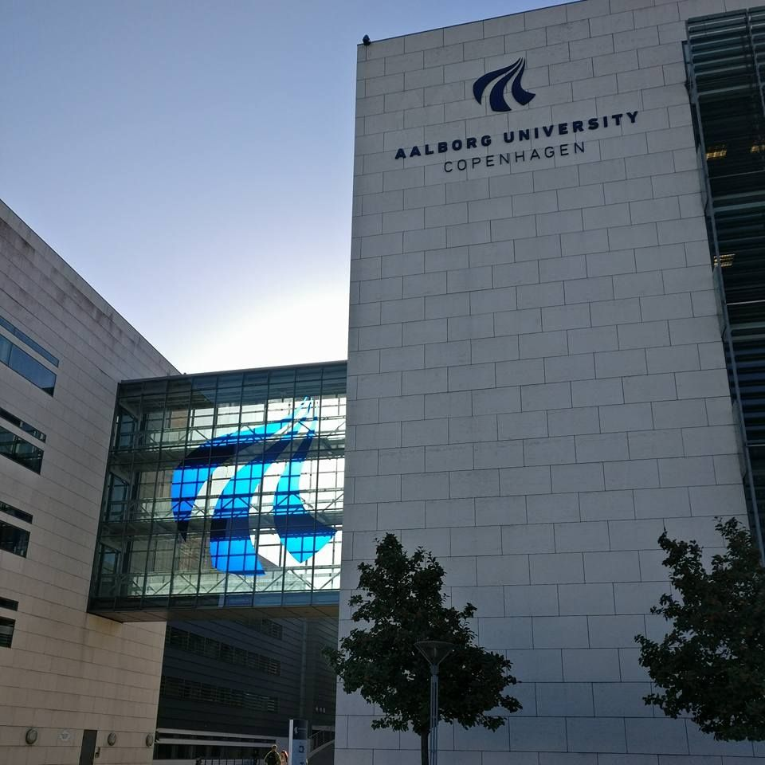
Aalborg
The tour will start in Aalborg
many industries trading with Greenland settled here.
Aalborg is home to one of the highest ranked universities in Europe.
World’s largest marine boiler manufacturer
Discovering Incredibly Outstanding Danish Electronics

Slide 7
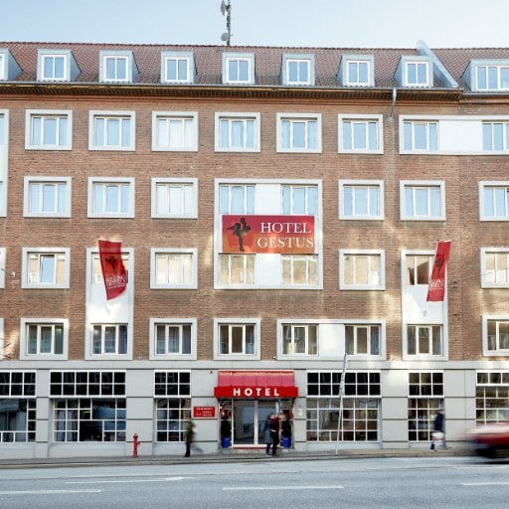
Aalborg
Milling Hotel Gestus
Discovering Incredibly Outstanding Danish Electronics

Slide 8
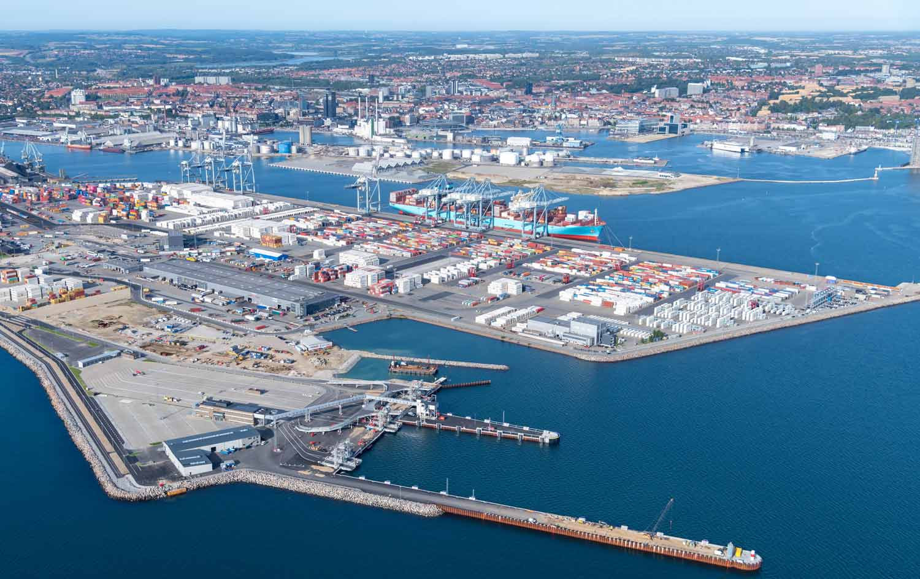
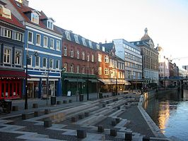
Aarhus
After Aalborg, we will travel down to Aarhus,
Old harbour city
Big container port
Discovering Incredibly Outstanding Danish Electronics

Slide 9
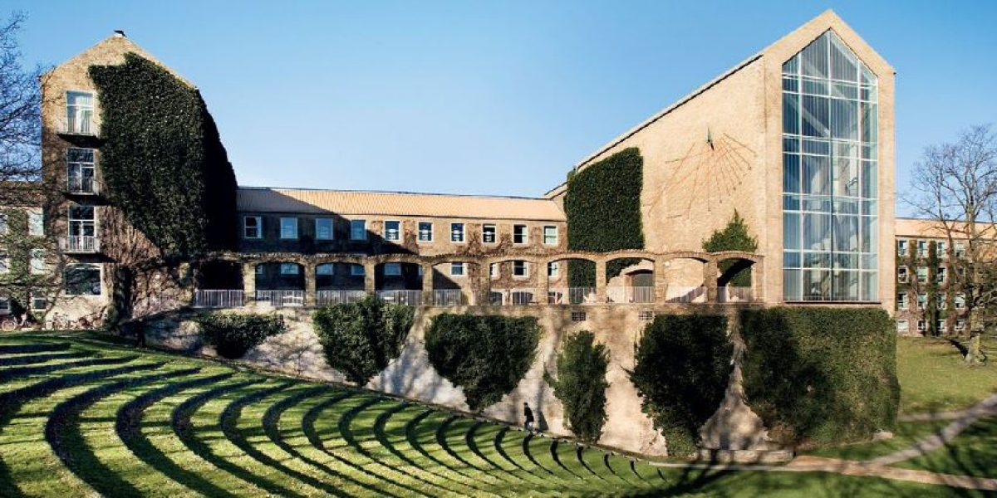
Aarhus
After Aalborg, we will travel down to Aarhus,
Connecting different parts of Denmark
Denmark's biggest company's headquarters
Many creative institutes
Biggest university in Scandinavia, the Aarhus University.
Wind turbines
Military
Discovering Incredibly Outstanding Danish Electronics

Slide 10
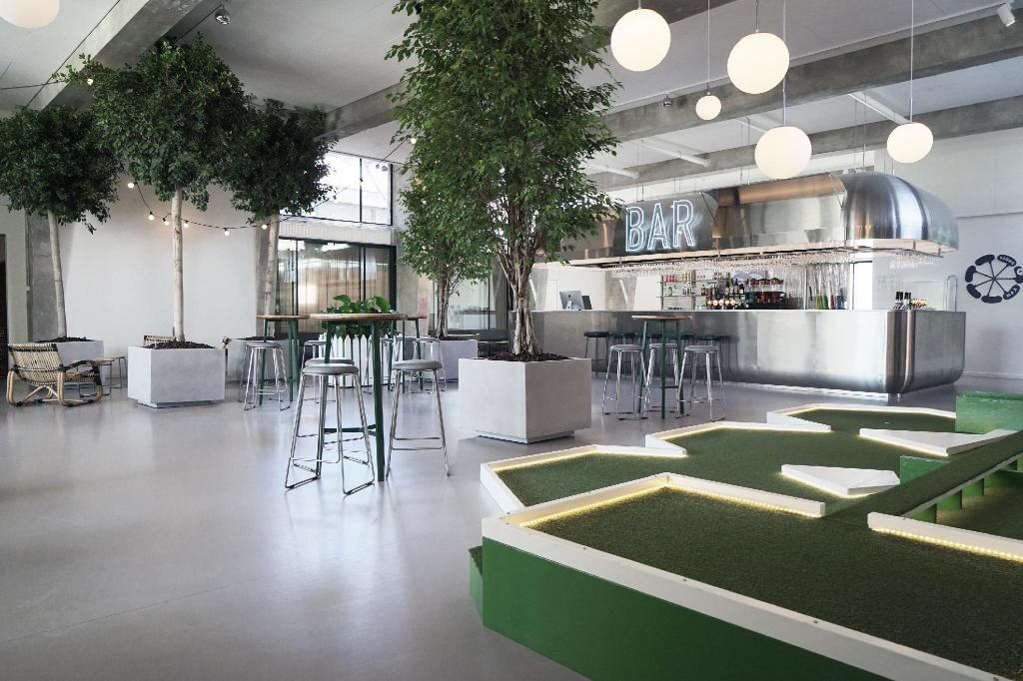
Aarhus
Book1 Hostel Aarhus
Discovering Incredibly Outstanding Danish Electronics

Slide 11
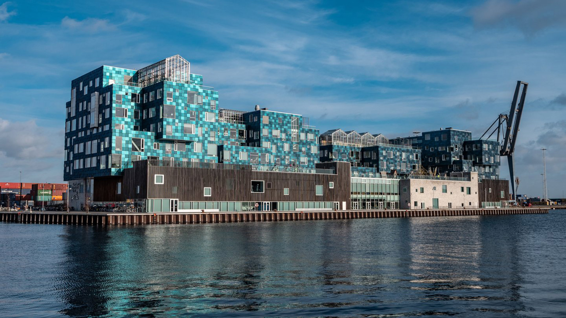
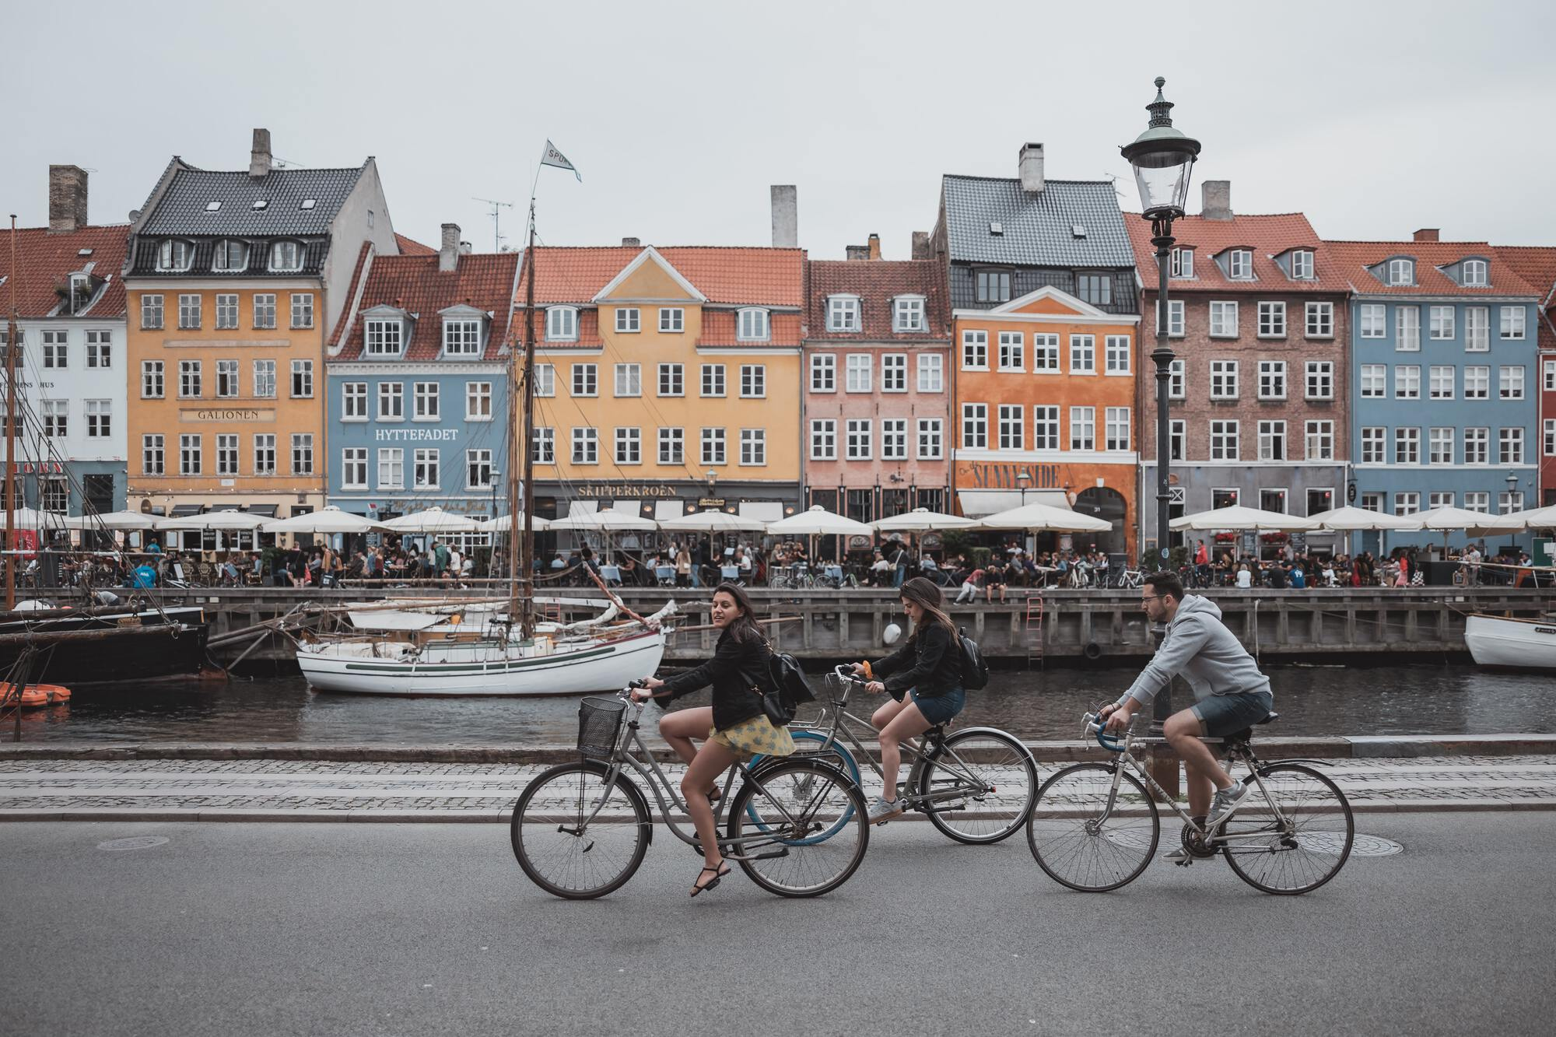
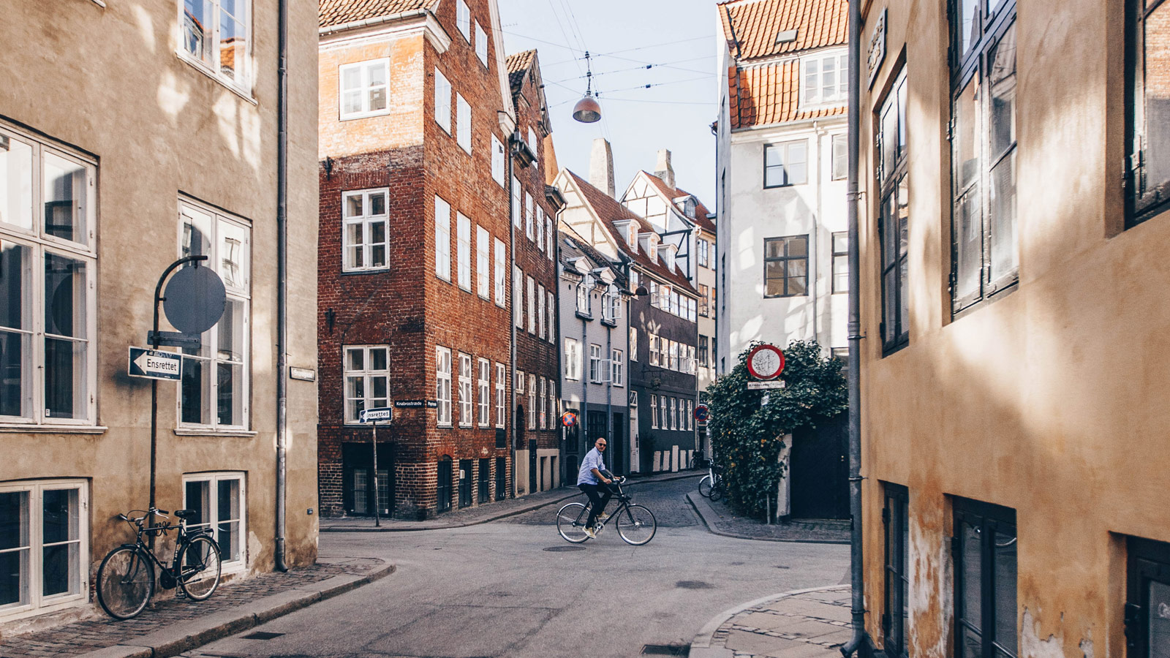
Copenhagen
Our final destination is Copenhagen.
Touristic
Known for its quality of life and green economy.
Beautiful architectures
Discovering Incredibly Outstanding Danish Electronics

Slide 12
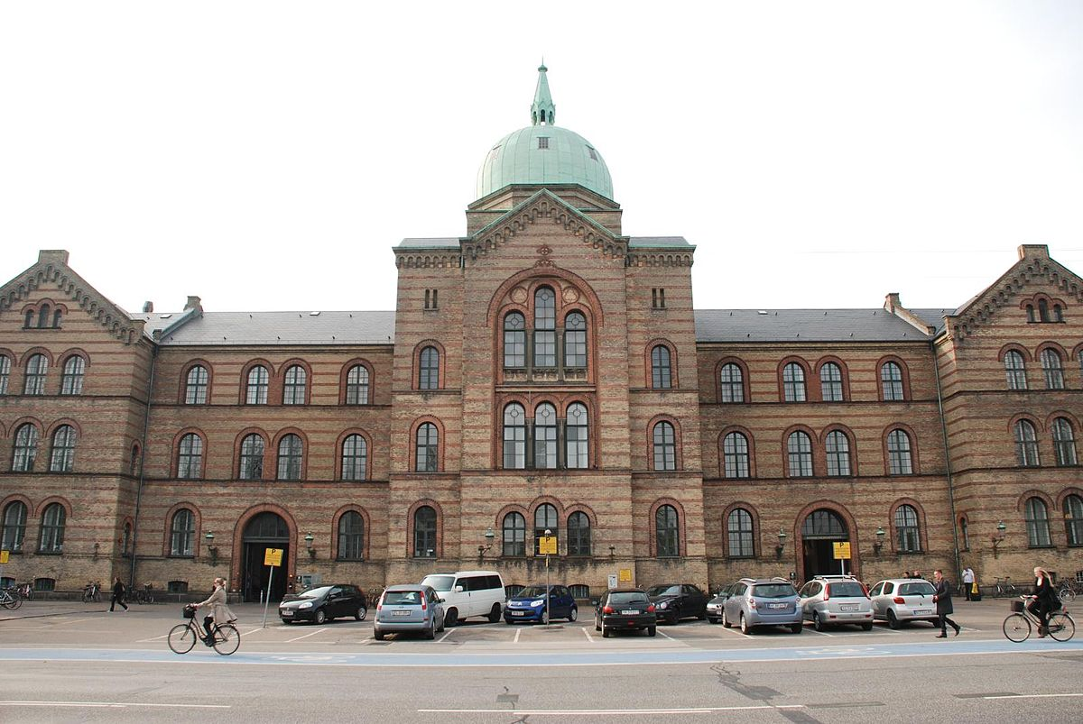
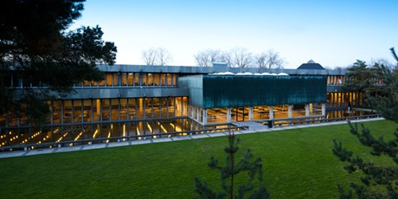
Copenhagen
Our final destination is Copenhagen.
Several universities (DTU and KU)
Business clusters in different innovation area’s
Life science being the most prominent (heart of ‘medicon valley’)
biotechnology
Pharmaceutic
Container logistics
Discovering Incredibly Outstanding Danish Electronics

Slide 13
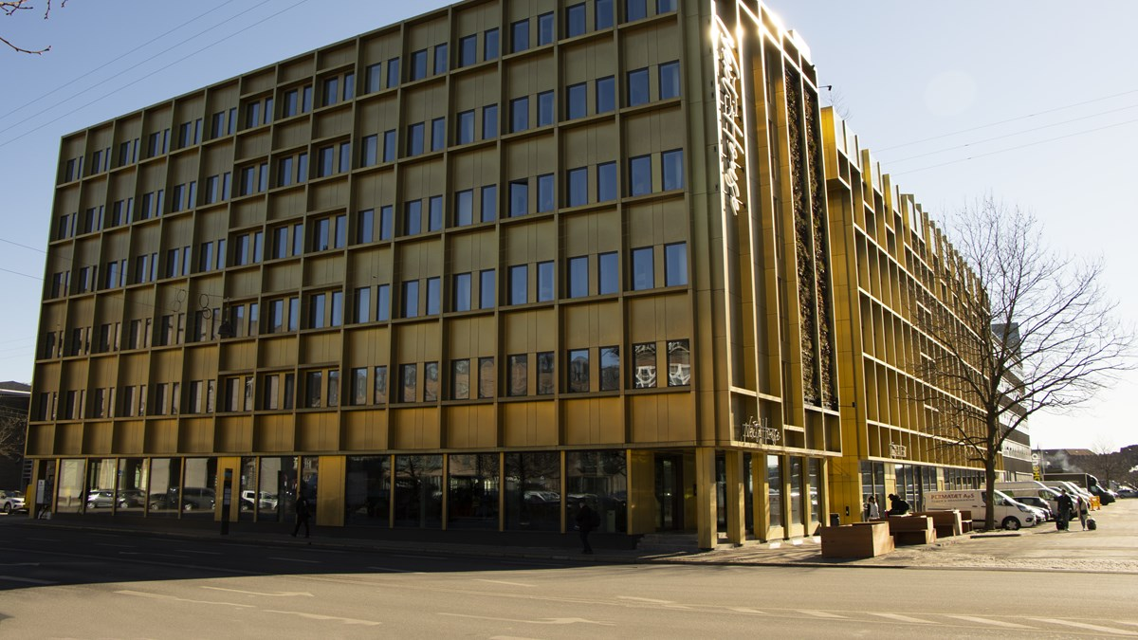
Copenhagen
Next House Copenhagen
Discovering Incredibly Outstanding Danish Electronics

Slide 14
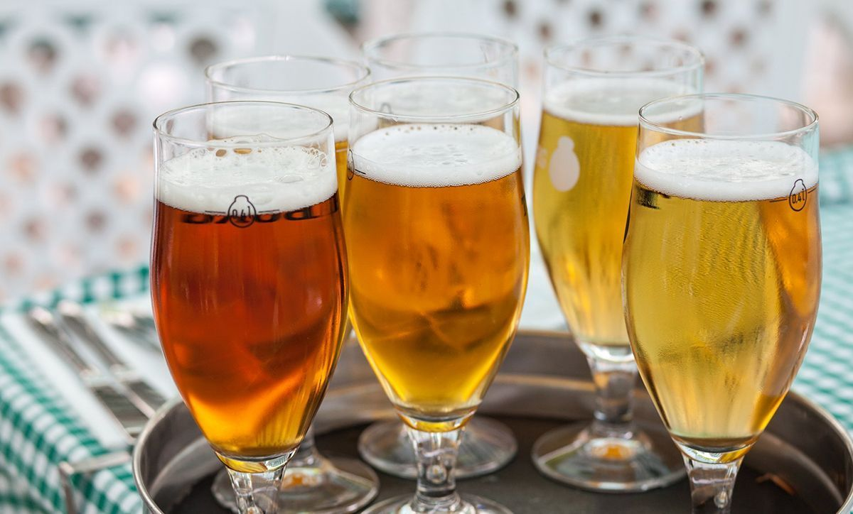
Copenhagen
Bakken Beer tour!
Discovering Incredibly Outstanding Danish Electronics

Slide 15
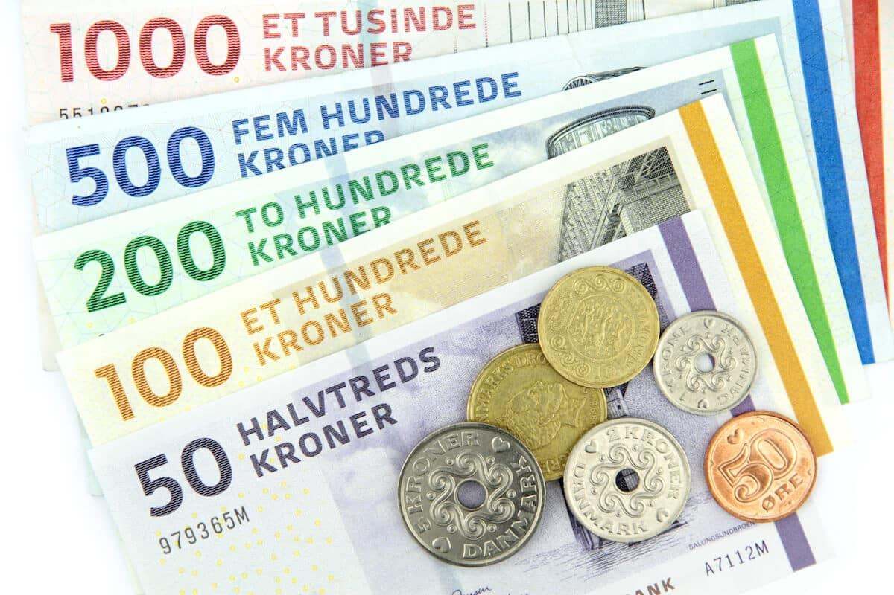
What do you get?
Travel (Bus, ferry)
Stay in 3 different hotels including breakfast
Breakfast on the bus on the first morning
Cool company visits
3 fun excursions
University visits
2 times dinner
A very cool DIODE sweater!
Discovering Incredibly Outstanding Danish Electronics

Slide 16
What does it cost?
Maximum price is 490 euro
Our aim is to reach 450 euro
Dependent on extra sponsoring and funding from UF/e
Payment:
Additional 50 euro deposit
Pay in one or two terms
One term:
540 euro before April 1st
Two terms
270 euro before April 1st
270 euro before May 1st
Discovering Incredibly Outstanding Danish Electronics

Slide 17
What next?
Subscribe for the trip!
Subscriptions close March 2nd at midnight
If the number of subscriptions surpass 30 people (including committee), a raffle will be held.
Raffle will be held on March 3rd, 12:45 in Flux 9.181
Afterwards, we’ll send out the participant contracts and your enrolment will be made final.
Around two weeks before the trip, we will have a final information meeting to go over more specifics of the trip
Discovering Incredibly Outstanding Danish Electronics

Slide 18
FAQ
I have the evening before the BuEx off, what can I do until we leave?
You can go to the BorrelXL. Just don’t drink too much, please.
I am an associate member, or not a Thor member, can I still join?
You can still join, but regular members do have priority. In case of a raffle, the list will be filled in order of: members, associate members, EE/AT students, other.
Where can I find these slides?
You can find them on our website, diode.thor.edu
Why no LegoLand?
Because it is very expensive and also way out of the way.
Discovering Incredibly Outstanding Danish Electronics

Slide 19
Questions?
Discovering Incredibly Outstanding Danish Electronics

